Slide 1
IP2003B
Final Project
Smart Home Assistant
第三組
110501566 陳柏翰
110501568 林冠丞
110502005林佑儒
110502518陳文獻

Slide 2
INTRODUCTION
Here’s the motivation:
As AI computing and IoT rises, the world is becoming increasingly interconnected
Implement the home assistant with materials at hand
Home assistant can be applied on unlocking home gates with recognized faces

Slide 3
COMPONENTS
01
02
03
04
05
Arduino
Raspberry Pi
FPGA board
Buzzer Control
Central System and LED Control
Accuracy and Identity display
Breadboard & Dupont Lines
Azure Face
Recognition Service
Connections
between Instruments
Connections
between Instruments

Slide 4
—魯迅
“到底是科技让人“懒惰”，
还是“懒惰”提高了科技？
┐(´д`)┌ .”

Slide 5
DIVE IN
Deep into our design

Slide 6
01
OVERVIEW
Let’s start.

Slide 7
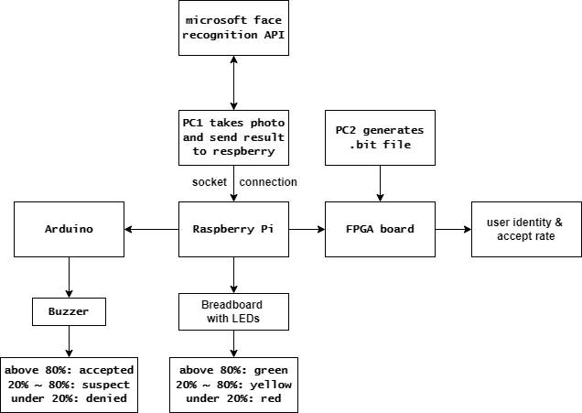
FLOW CHART

Slide 8
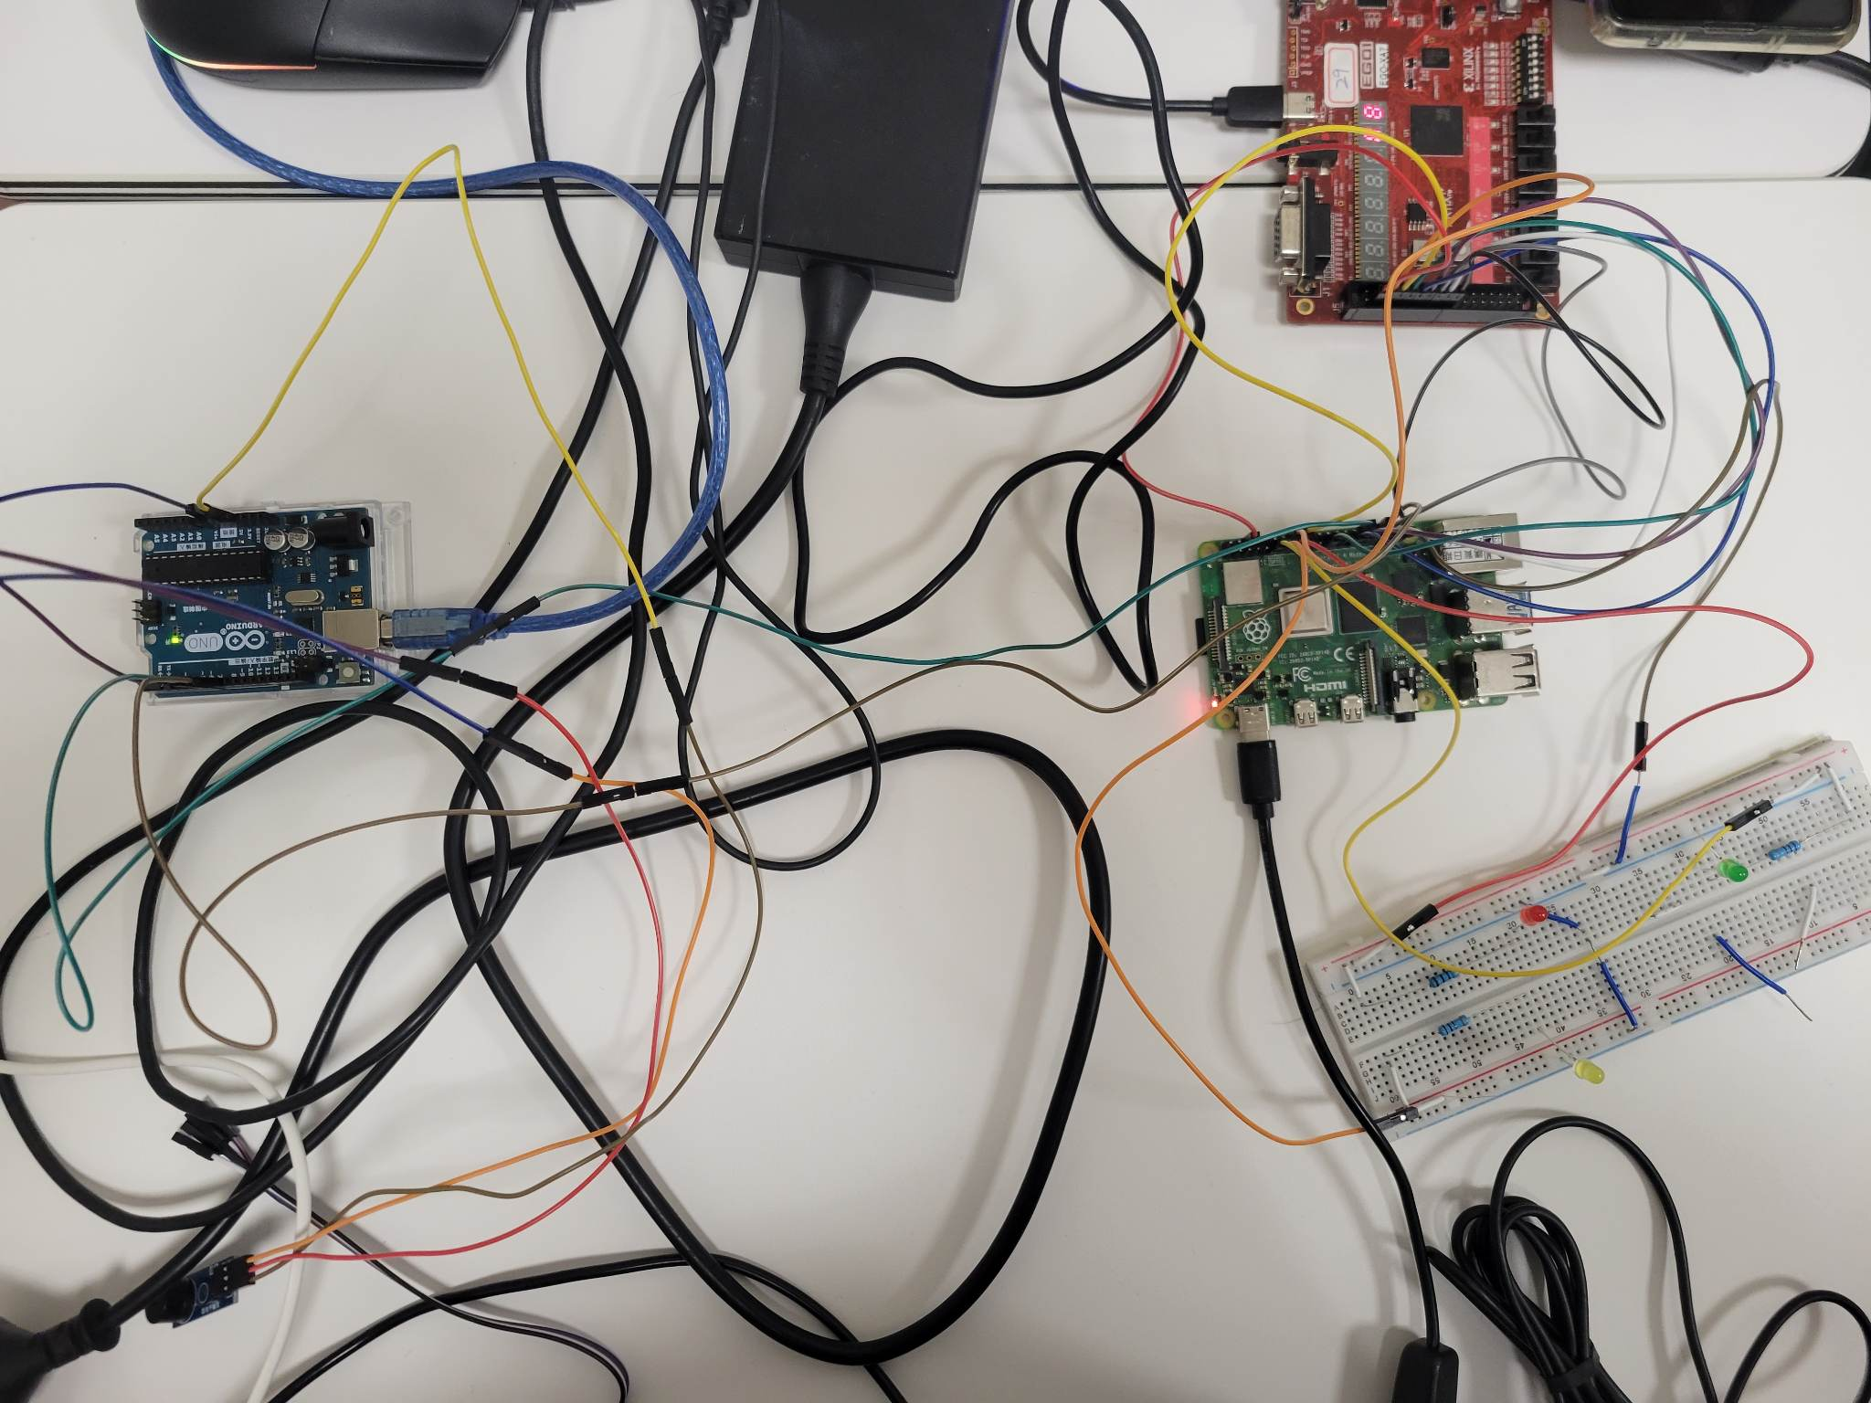
OVERVIEW
From the left side, we have Arduino controlling the buzzer; on the right side, we got the FPGA board , then the Raspberry Pi and the breadboard with LEDs inserted on it.

Slide 9
ARDUINO & BUZZER
The Arduino board is in charge of controlling the buzzer, when different accepted rate is received from the PC (with MobaXterm) through the Raspberry Pi, different sound effect is applied.
Arduino itself is a finite-state machine with four states: Accept (confidence > 80), Suspect (confidence 20-80),Unrecognizable(confidence < 20) and Idle, controlled by a 2-bit signal from Raspberry Pi

Slide 10
FPGA BOARD
From the right side, we have the FPGA board controlled by another PC. On the left side seven segment display shows either the identity of the users and the “accepted” word from the built-in galleries on the Microsoft Cloud with their names respectively, or giving “error” if the accept rate is under standard.
On the right side seven segment display (the rightmost two display) gives the accept rate in decimal numbers.
The LEDs on the FPGA act as an loading bar. d(`･∀･)b

Slide 11
RASPBERRY PI AND LEDs
The last part of our design is the central system: Raspberry Pi. It transmits signals from the PC to the Arduino in order to control the buzzer, while controlling the LEDs by itself through dupont lines.
The green LED is ignited when the accept rate is above 80%; the yellow LED turns on when the accept rate is between 20% & 80%; and the red LED turns on under 20%.

Slide 12
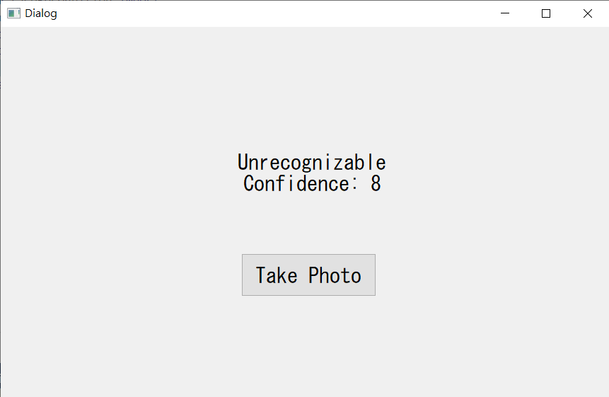
Graphical User Interface
We also made a simple graphical user interface for it using PyQt5.
The GUI has a “Take Photo” button, which initiates the recognition process.
The result of the recognition and confidence is shown on the label above.

Slide 13
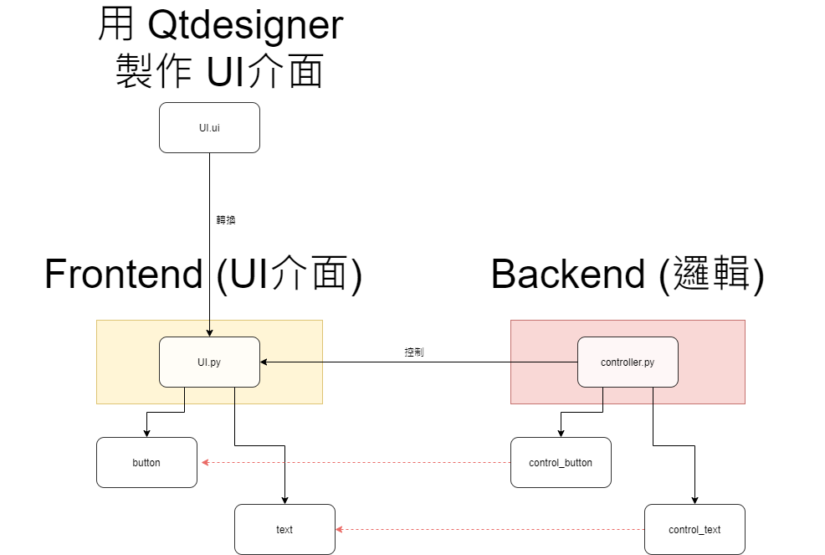
PyQt Concept

Slide 14
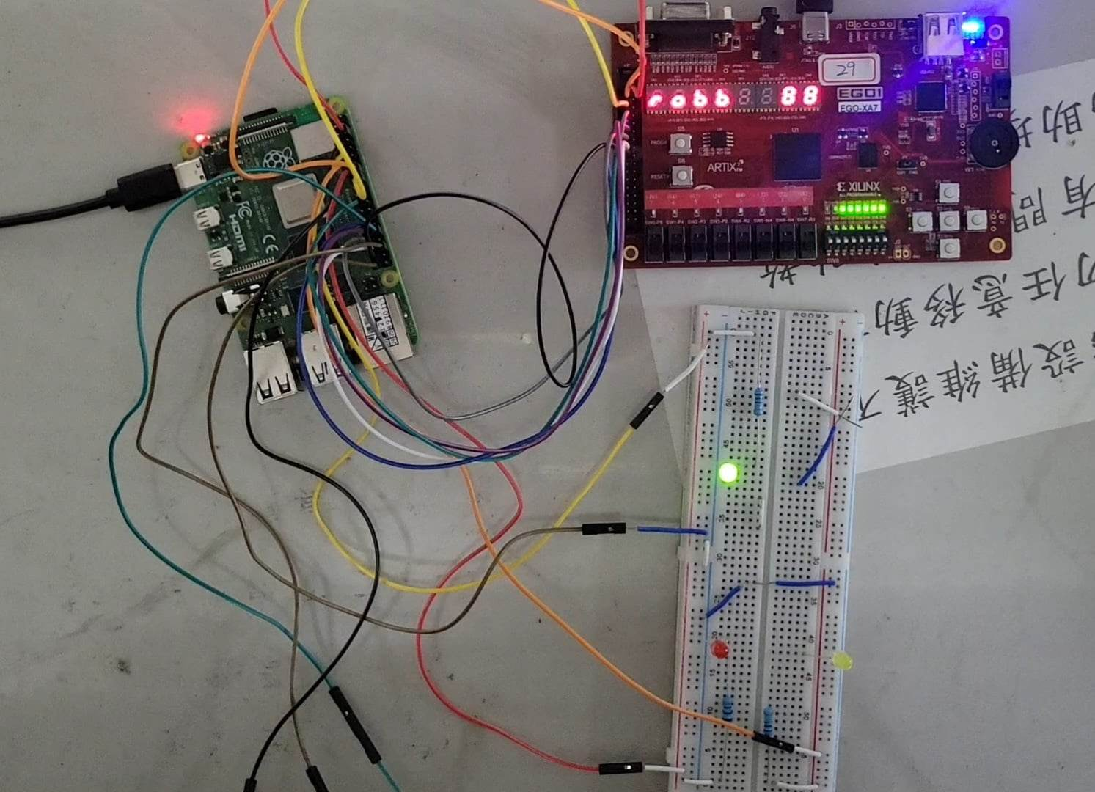
Demonstration-1
So, let’s get started. To begin with, we first take a photo from the camera from the PC through the graphical user interface.
This showed a successful recognition (robb), with a green LED, a confidence rate above 80 (88), and the identity from the human face library. The FPGA board meanwhile was turned on sequentially from right to left, which worked as a loading bar.

Slide 15
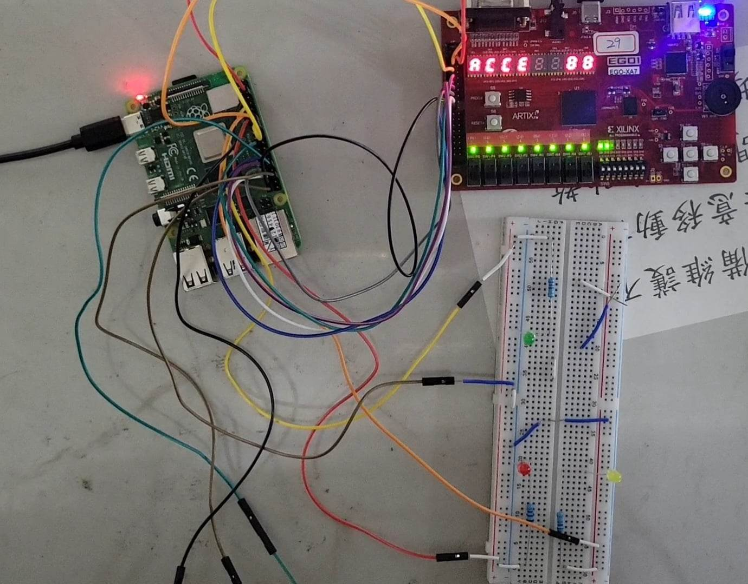
Demonstration-2
After displaying the identity, the accepted word, “ACCE”, appeared on the seven segment display on the left side. The LED array on the FPGA board meanwhile was turned on sequentially from left to right, also worked as a loading bar.

Slide 16
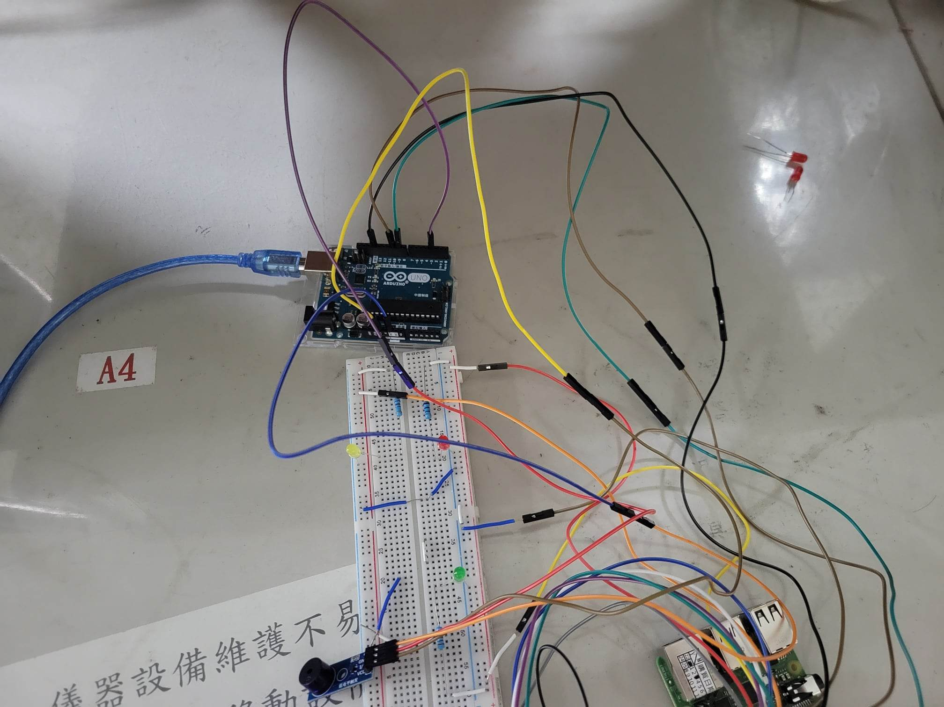
Demonstration-3
At last, the buzzer in the bottom part from the photo gave a sound depending on different confidence rate.

Slide 17
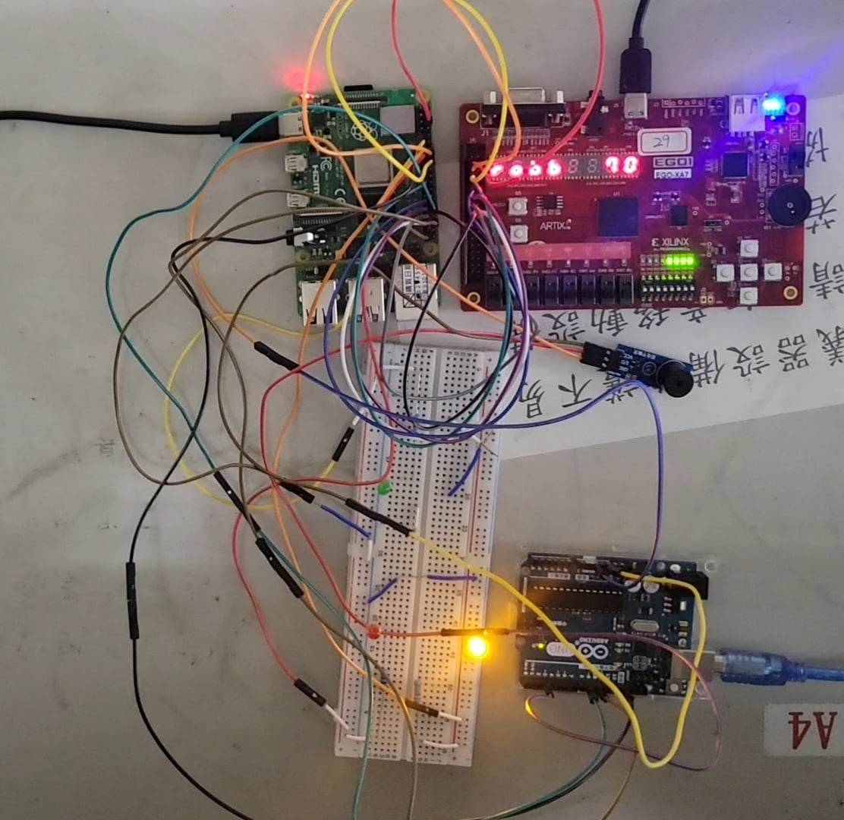
Demonstration-4
This time, our member robb wore a mask to test the “not so sure” recognition output. Hence, the seven segment display showed a confidence rate at 70, which was between 20 and 80, so the yellow LED was turned on.

Slide 18
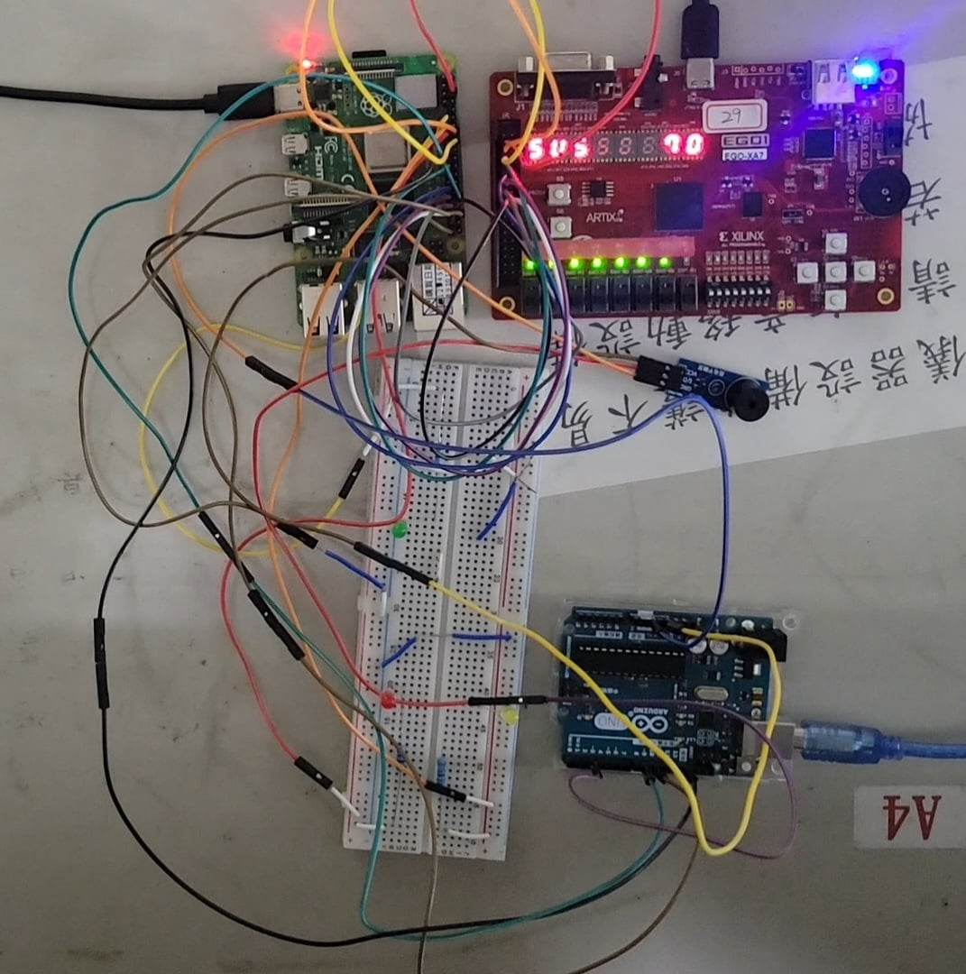
Demonstration-5
Later on, the suspect word “SUS” was shown after the identity. The buzzer also gave another sound due to the confidence rate.

Slide 19
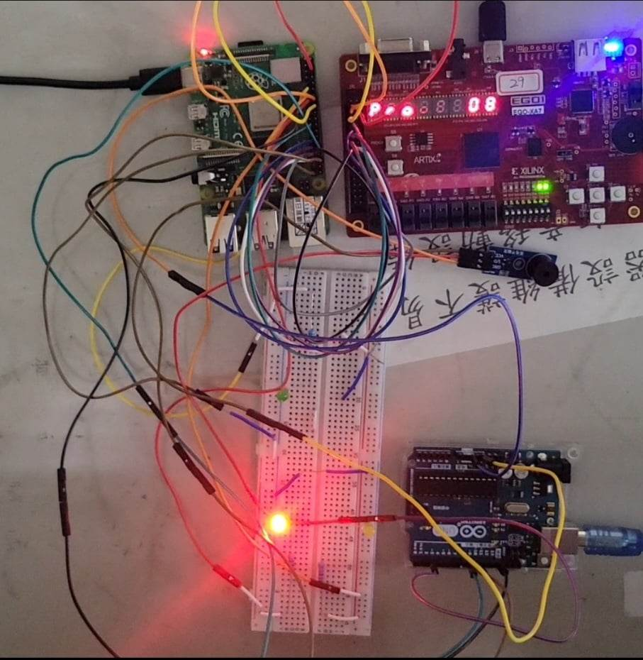
Demonstration-6
Finally, we decided to test the denied result. We brought the general secretary of China, Xi’s photo to the camera, unsurprisingly, we received a red light and a low confidence rate (08) from the seven segment display. As for the name, please ignore it since the face recognition service gives an most-likely identity even the person’s face doesn’t exist in the library.

Slide 20
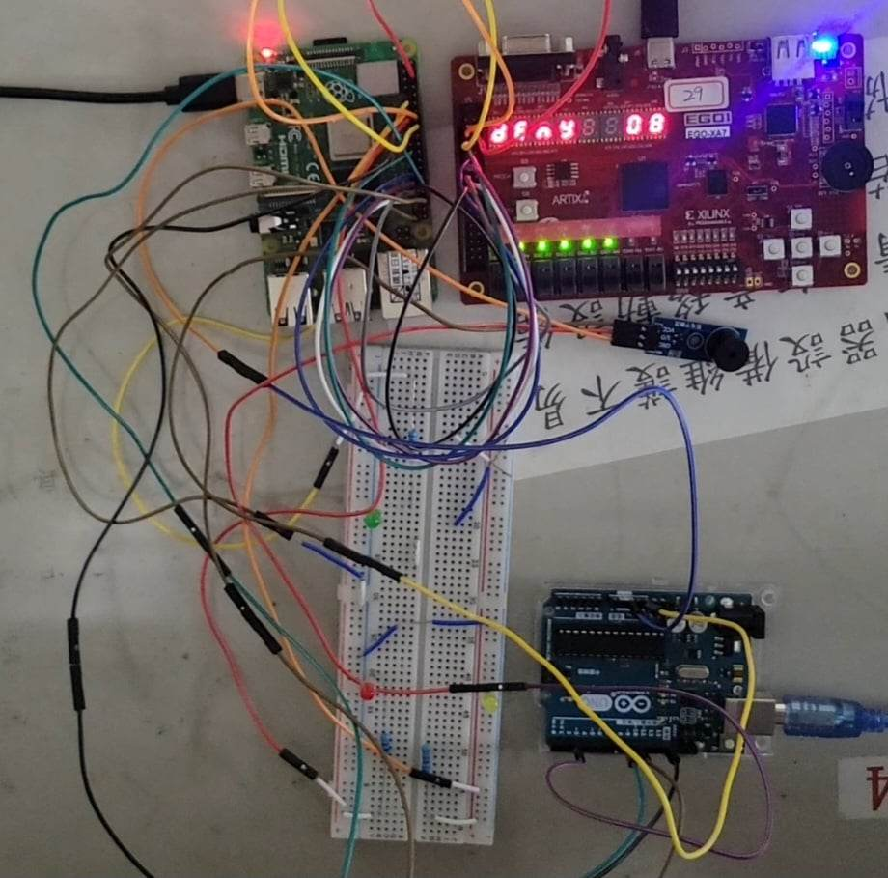
Demonstration-7
Last but not least, the denied word “deny” is shown in the seven segment display. And the buzzer also gave the other sound other than the two recognition results.

Slide 21
Some Challenges
Problem: 樹莓派操作蜂鳴器時，放出的聲音頻率比預期低，且拍子被拉長很多
Solution: 發現是因為多線程之間切換的延遲所致，蜂鳴器對於訊號的延遲非常敏感，而Raspberry Pi無法滿足低延遲的要求，最後透過改用arduino輸出訊號給蜂鳴器解決
Problem: 樹莓派的LOW輸出無法被arduino穩定識別為LOW，而是在HIGH與LOW之間上下跳
Solution: 原因是樹莓派與arduino之GND電位不同，透過共地即可解決

Slide 22
Code
https://docs.google.com/document/d/1mJzI-qcQcQEs7_NcvyNQBQ2v1e5TZXMLnh_gUsT_nR8/edit
說明: 上方為python程式碼跟arduino程式碼
下方為verilog程式碼，透過vivado執行並生成 .bit檔，燒錄至FPGA上

Slide 23
THANKS
Do you have any questions?
You can raise your hands and give some feedbacks.
Please keep this slide for attribution

